Slide 1
A Machine Learning Approach to End­-to-­End RTT Estimation
Presented by:
A.H.M.Osama Haque ID: 1805002

Slide 2
References
Paper Link: https://ieeexplore.ieee.org/abstract/document/6006098
Author: Nunes, Bruno AA, et al.
Conference: 20th International Conference on Computer Communications and Networks (ICCCN)
Year: 2011
Cited by: 34
Recent citation: 2020

Slide 3
Core Modification
Current:
TCP’s estimate of the RTT employs a widely used technique: the “Exponential Weighted Moving Average (EWMA)”.
Proposed:
A machine-learning based approach called the “Fixed-Share Experts Framework”

Slide 4
Motivation
To help us generate a suitable value for Retransmission Time Out (RTO) and thus prevent serious network stalls.
To inspect network latency and act accordingly.
To help us improve overall quality of network

Slide 5
Methodology
A number of “experts” make predictions, which is compared to the actual value.
The predictions are used to estimate RTT with initial constant weights.
Using the prediction error, we refine the weights of the predictions
The updated weights are used in the next iteration of the algorithm.

Slide 6
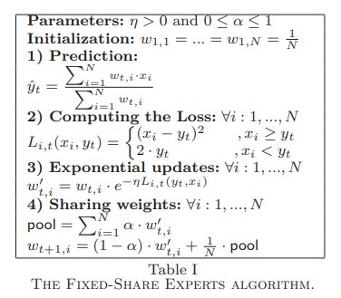
Proposed Algorithm

Slide 7
Expectation
A reduction in the number of retransmitted packets.
Yield higher RTT estimation accuracy

